Slide 1
Waveform + Music Generation using Cordic Algorithm
By: Shankar, Naveen, Guha, Ketan

Slide 2
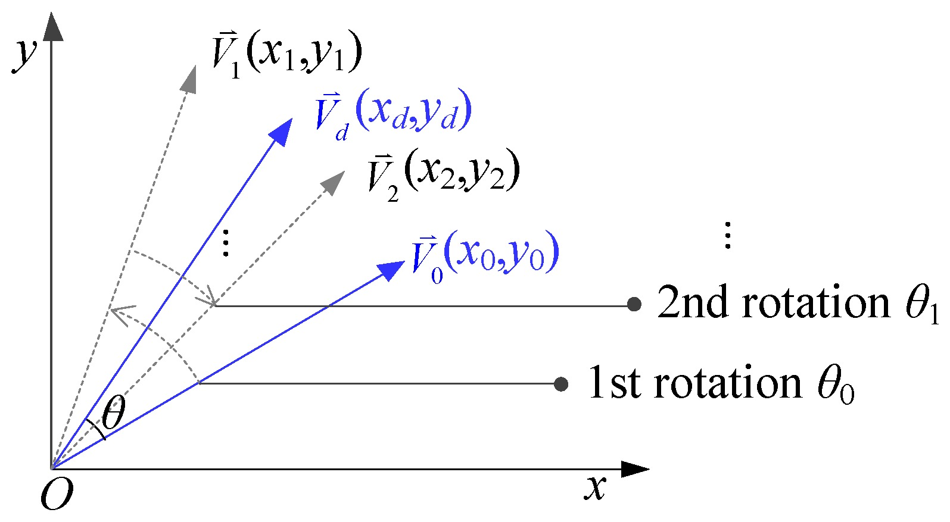
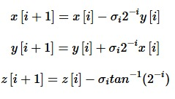
Principle:

Slide 3
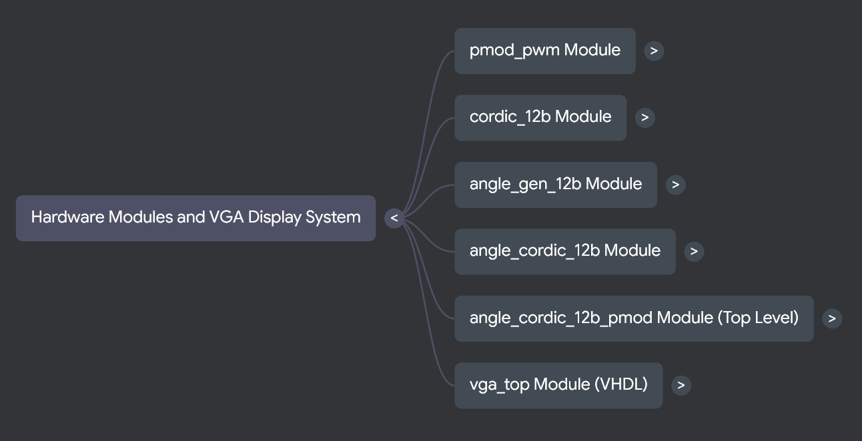

Slide 4
Hardware Optimisations
Pipelined Implementation for the cordic block to maximize the throughput
Reduced the data-width to fit in the area required
Not using external memory. All the compute is on-the-fly basis
No Data buffer for the VGA Module

Slide 5
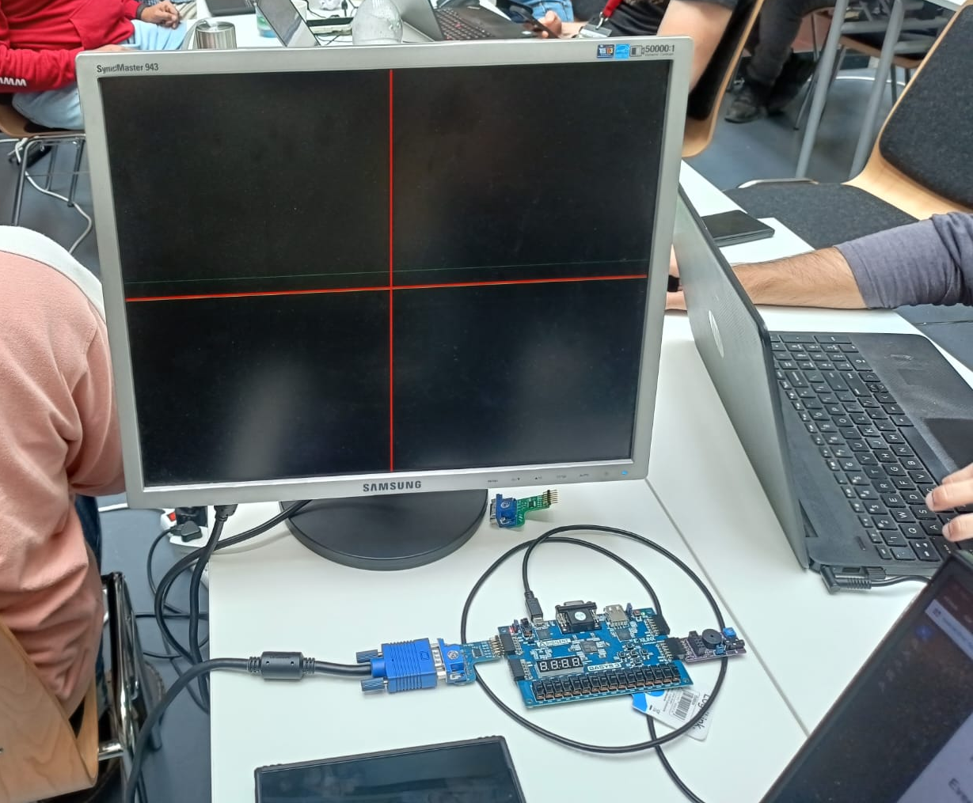
Setup:

Slide 6
Verification:-
Module level test benches for Individual Blocks
Functional verification of setup – Demo available
Developing an integrated test bench for the whole architecture (WIP)

Slide 7
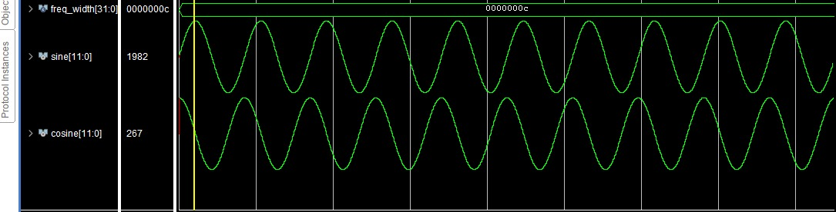
Simulated Waveforms:

Slide 8
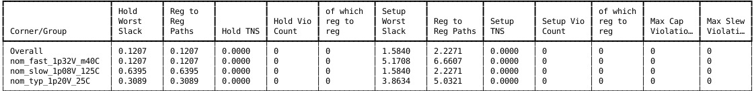
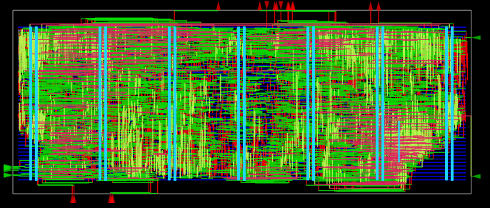
LibreLane results:
*Design is run at 100MHz

